Slide 1
Assignment 3- Retransmission & Congestion Control
A I – C h u n P a n g / I n s t r u c t o r
戴維均 陳昇 / T . A . s

Slide 2
What is Go-Back-N?

Slide 3
Go-Back-N case 1 (working normally)
Window size
Sender
1 | 2 | 3 | 4 | 5 | 6 | 7 | 8 | 9 | 10
5
4
3
2
Time
1
Packet
Receiver
Ack

Slide 4
Go-Back-N case 1 (working normally)
Window size
Sender
1 | 2 | 3 | 4 | 5 | 6 | 7 | 8 | 9 | 10
1
2
3
4
Time
5
Packet
Receiver
1 | 2 | 3 | 4 | 5
Ack

Slide 5
Go-Back-N case 1 (working normally)
Window size
Sender
1 | 2 | 3 | 4 | 5 | 6 | 7 | 8 | 9 | 10
6
2
3
4
5
Time
Packet
Receiver
1 | 2 | 3 | 4 | 5
Ack

Slide 6
Go-Back-N case 2 (packet loss)
Window size
Sender
1 | 2 | 3 | 4 | 5 | 6 | 7 | 8 | 9 | 10
5
4
Packet loss
2
Time
1
Packet
Receiver
Ack

Slide 7
Go-Back-N case 2 (packet loss)
Window size
Sender
1 | 2 | 3 | 4 | 5 | 6 | 7 | 8 | 9 | 10
1
2
5
Time
Packet
1 | 2
Receiver
4
Ack
Discard

Slide 8
Go-Back-N case 2 (packet loss)
Window size
Sender
1 | 2 | 3 | 4 | 5 | 6 | 7 | 8 | 9 | 10
1
2
5
Time
2
Packet
Receiver
1 | 2
Ack

Slide 9
Go-Back-N case 2 (packet loss)
Window size
Sender
1 | 2 | 3 | 4 | 5 | 6 | 7 | 8 | 9 | 10
2
6
2
2
Time
Packet
Receiver
1 | 2
Ack

Slide 10
Go-Back-N case 2 (packet loss)
Window size
Sender
1 | 2 | 3 | 4 | 5 | 6 | 7 | 8 | 9 | 10
7
6
2
2
Time
Packet
Receiver
1 | 2
Ack

Slide 11
Go-Back-N case 2 (packet loss)
Window size
Sender
1 | 2 | 3 | 4 | 5 | 6 | 7 | 8 | 9 | 10
7
Time
Packet
1 | 2
Receiver
6
Ack
Discard

Slide 12
Go-Back-N case 2 (packet loss)
Timeout!
Window size
Sender
1 | 2 | 3 | 4 | 5 | 6 | 7 | 8 | 9 | 10
2
2
Time
Packet
Receiver
1 | 2
Ack

Slide 13
Go-Back-N case 2 (packet loss)
Window size
Sender
1 | 2 | 3 | 4 | 5 | 6 | 7 | 8 | 9 | 10
4
3
Time
Packet
Receiver
1 | 2
Ack

Slide 14
Go-Back-N with Congestion Control

Slide 15
Go-Back-N + Congestion Control
Sender sends Data 1
Congestion window = 1. Threshold = 2
Receiver sends ACK 1
Sender
1
1
1
Packet
Receiver
Ack

Slide 16
Go-Back-N + Congestion Control
Sender sends Data 2,3
Congestion window =2, Threshold =2;
Receiver sends ACK 2,3
Sender
2 | 3
2
2
3
3
Packet
Receiver
1
Ack

Slide 17
Go-Back-N + Congestion Control
Sender sends Data 4,5,6
Congestion window = 3; Threshold = 2;
Receiver drops Data 5, sends ACK 3, drops Data 6, sends ACK 3
Sender
4 | 5
6
4
5
3
6
3
Packet
Receiver
1 | 2 | 3
Discard
Ack
Discard

Slide 18
Go-Back-N + Congestion Control
Sender sends Data 4
Congestion window = 1, Threshold = 1;
Receiver sends ACK 4
Sender
4
4
4
Packet
Receiver
1 | 2 | 3
Ack

Slide 19
Go-Back-N + Congestion Control
Sender sends Data 5,6
Congestion window = 2; Threshold = 1;
Receiver sends ACK 5, drops Data 6, flush buffer()
Sender
5
6
5
5
6
5
Packet
Receiver
1 | 2 | 3 | 4
Buffer Overflow
Ack

Slide 20
Go-Back-N + Congestion Control
Sender sends Data 1
Congestion window = 1. Threshold = 1
Receiver sends ACK 6
Sender
6
6
6
Packet
Receiver
Ack

Slide 21
Assignment 3 Announcement

Slide 22

Specification (1/10)
Implement three components: sender, receiver and agent.
Sender / Receiver
Send / receive video frame by UDP
Provide reliable transmission
Congestion control
Agent
Forward Data & ACK packets
Randomly drop data packets
Compute loss rate
Data 1
Data 1
Ack 1
Ack 1
Sender
Agent
Receiver

Slide 23
Specification (2/10)
Reliable Transmission
Data & ACK
Time out & Retransmission(Go-Back-N)
Sequence number
Completeness and correctness of transmitted file
Buffer handling [receiver side]
Buffer Overflow:
Drop the packets during out of buffer
Flush (write) to the file:
Only when buffer overflows or all packets in range are received.

Slide 24
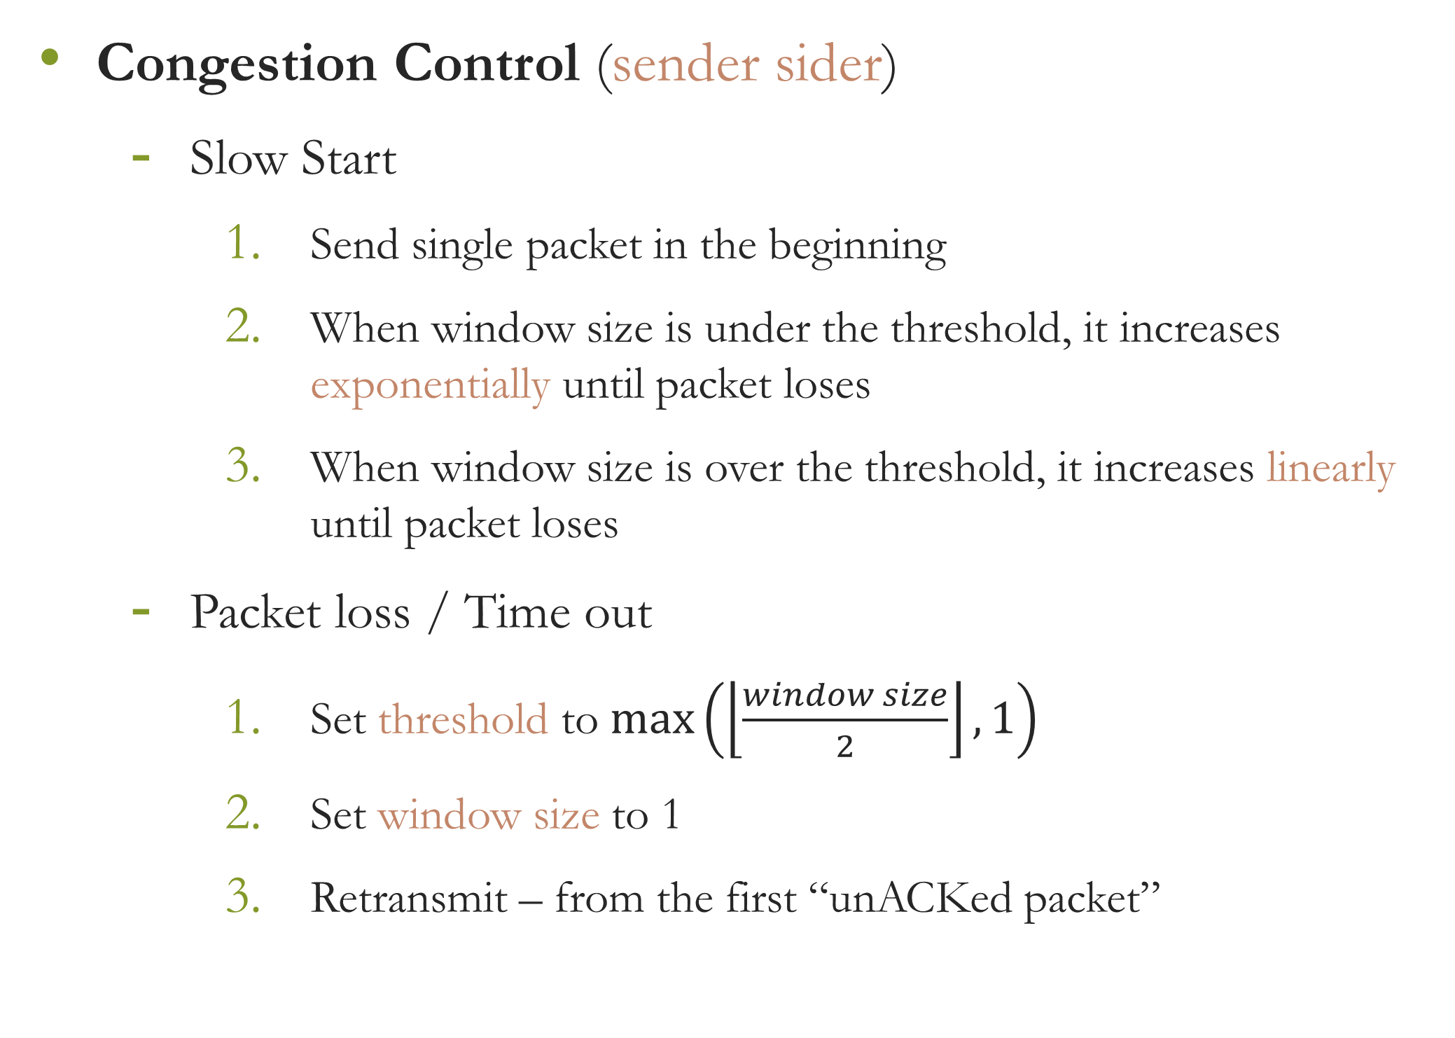
Specification (3/10)
Congestion Control (sender sider)
Slow Start
Send single packet in the beginning
When window size is under the threshold, it increases exponentially until packet loses
When window size is over the threshold, it increases linearly until packet loses
Packet loss / Time out
Set threshold to $max\left(\left\lfloor \frac{window size}{2}\right\rfloor ,1\right)$
Set window size to 1
Retransmit – from the first “unACKed packet”

Slide 25
Specification (4/10)
Show Message
Sender: send, recv, data, ack, fin, finack, sequence number, time out, resnd, winSize, threshold
Receiver: send, recv, data, ack, fin, finack, sequence number, drop, flush
Agent: get, fwd, data, ack, fin, finack, sequence number, drop, loss rate

Slide 26
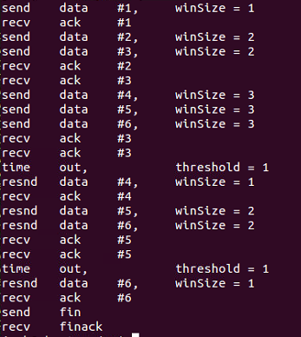
Specification (5/10)
Show Message
Sender:

Slide 27
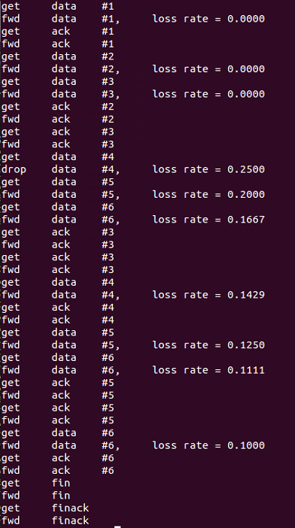
Specification (6/10)
Show Message
Agent:

Slide 28
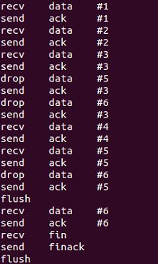
Specification (7/10)
Show Message
Receiver:

Slide 29
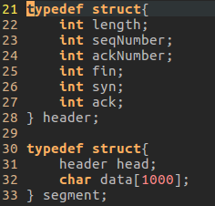
Specification (8/10)
Show Message
The format used for transmission should be the same as follow:
fin: 0 or 1
syn: 0 or 1 (just make it 0)
ack: 0 or 1

Slide 30

Specification (9/10)
Settings
Sender
Arguments: IP, Port, path of source file,… etc.
Default threshold:16
Receiver
Arguments: IP, port, … etc.
Default buffer size: 32 segments
Agent
Arguments: IP, port, loss rate, … etc.
Data packet size (payload): 4KB
Time out: Less than or equal to 1 sec ($≤1 sec$)

Slide 31
Specification (10/10)
Makefile
You are required to write a Makefile for compilation.
Thus, the commands should be:
$make server // for server code
$make agent // for agent code
$make receiver // for receiver code
After the compilation, there should be 3 executables:
server, agent and receiver.

Slide 32
Grading Policy (1/2)
This assignment accounts for 10% of the total score.
Video Streaming (15%)
- Correctly play the sample video in HW2
- Transmit raw frames (5%)
- Transmit encoded frames (10%)
- Correctly play resolution-unknown videos (5%)
Reliable transmission (20%)
Congestion control (25%)
Buffer handling (10%)
Agent (9%)
Randomly drop data packet (5%)
Compute loss rate (4%)
Show Message (9%)
Show message correctly (3% * 3)
Report (12%)
How to execute your program (3%)
Explain your program structure (3% * 3) (including 3 flow charts for sender, agent and receiver)

Slide 33
Grading Policy (2/2)
Submission
Your report format must be in “.pdf” format and named “report.pdf”, or else you will get 0 point in the part.
Please put all the files into a folder named hw3_<student id>, compress the folder as a .zip file, and then submit the .zip file to NTU Cool. The zip filename is hw3_<student id>.zip .
If we cannot compile or execute your code, you will have a chance to demo your results in your own environment.
The penalty for wrong format is 10 points.
No plagiarism is allowed. A plagiarist will be graded 0.
Deadline
Due Date: 23:59:59, January 5th, 2021
Penalty for late submission after hard deadline is “10% per day”.

